Slide 1
Incident Monitoring and Responsible Production
A real-time incident reporting solution by drones to reduce the time required to perform tasks by replacing human inspection.

Slide 2
Current Industrial Challenges
Power and Utilities
Oil & Gas Operations
Technology & Telecommunication
Manual Inspection of pressure vessels ,boilers and burners is risky and exposure to radiation is high.
Manual Detection of oil pipelines is time-consuming and also incurs high risk to human personnel during leakage or breakage.
Oil Spills and Gas leakages spread quickly contaminating the environment and leads to serious health hazards.
Restricted access and untimely monitoring of cables and equipment failures can lead to major accidents in telecom towers.

Slide 3
Proposed Solution
Power and Utilities
Oil & Gas Operations
Technology & Telecommunication
Drones can fly into pressure vessels and boilers, collecting video footage of every single burner and pipe.
Reducing risk of Radiation Exposure to humans by making a drone easily fly over the top of a nuclear power plant.
Drone Surveillance for real-time assessment of pipeline health and surroundings.
Incident detection such as Oil spills and gas leakages through low-altitude drones, during midstream transportation.
Drones can help first responders to quickly canvas the incident area and initiate emergency protocols effectively.
Security Drones can be deployed to monitor risks and perimeters of factories and warehouses.
Drones can identify electrical sparking between cables ,disorientation of antennas in towers and us mitigating the same.

Slide 4
Solution Detail
A dashboard for a Factory or a Site Manager which will enable him or her to view insights on various incidents occurred for a specific time span.
Real-time monitoring of warehouses, factories and telecom towers to identify threats due to fire outbursts, gas leakages and other hazardous incidents.
Drone equipped with cameras which will be able to identify incidents and other unusual activities through remote computer vision and artificial intelligence.

Slide 5
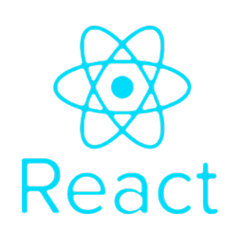
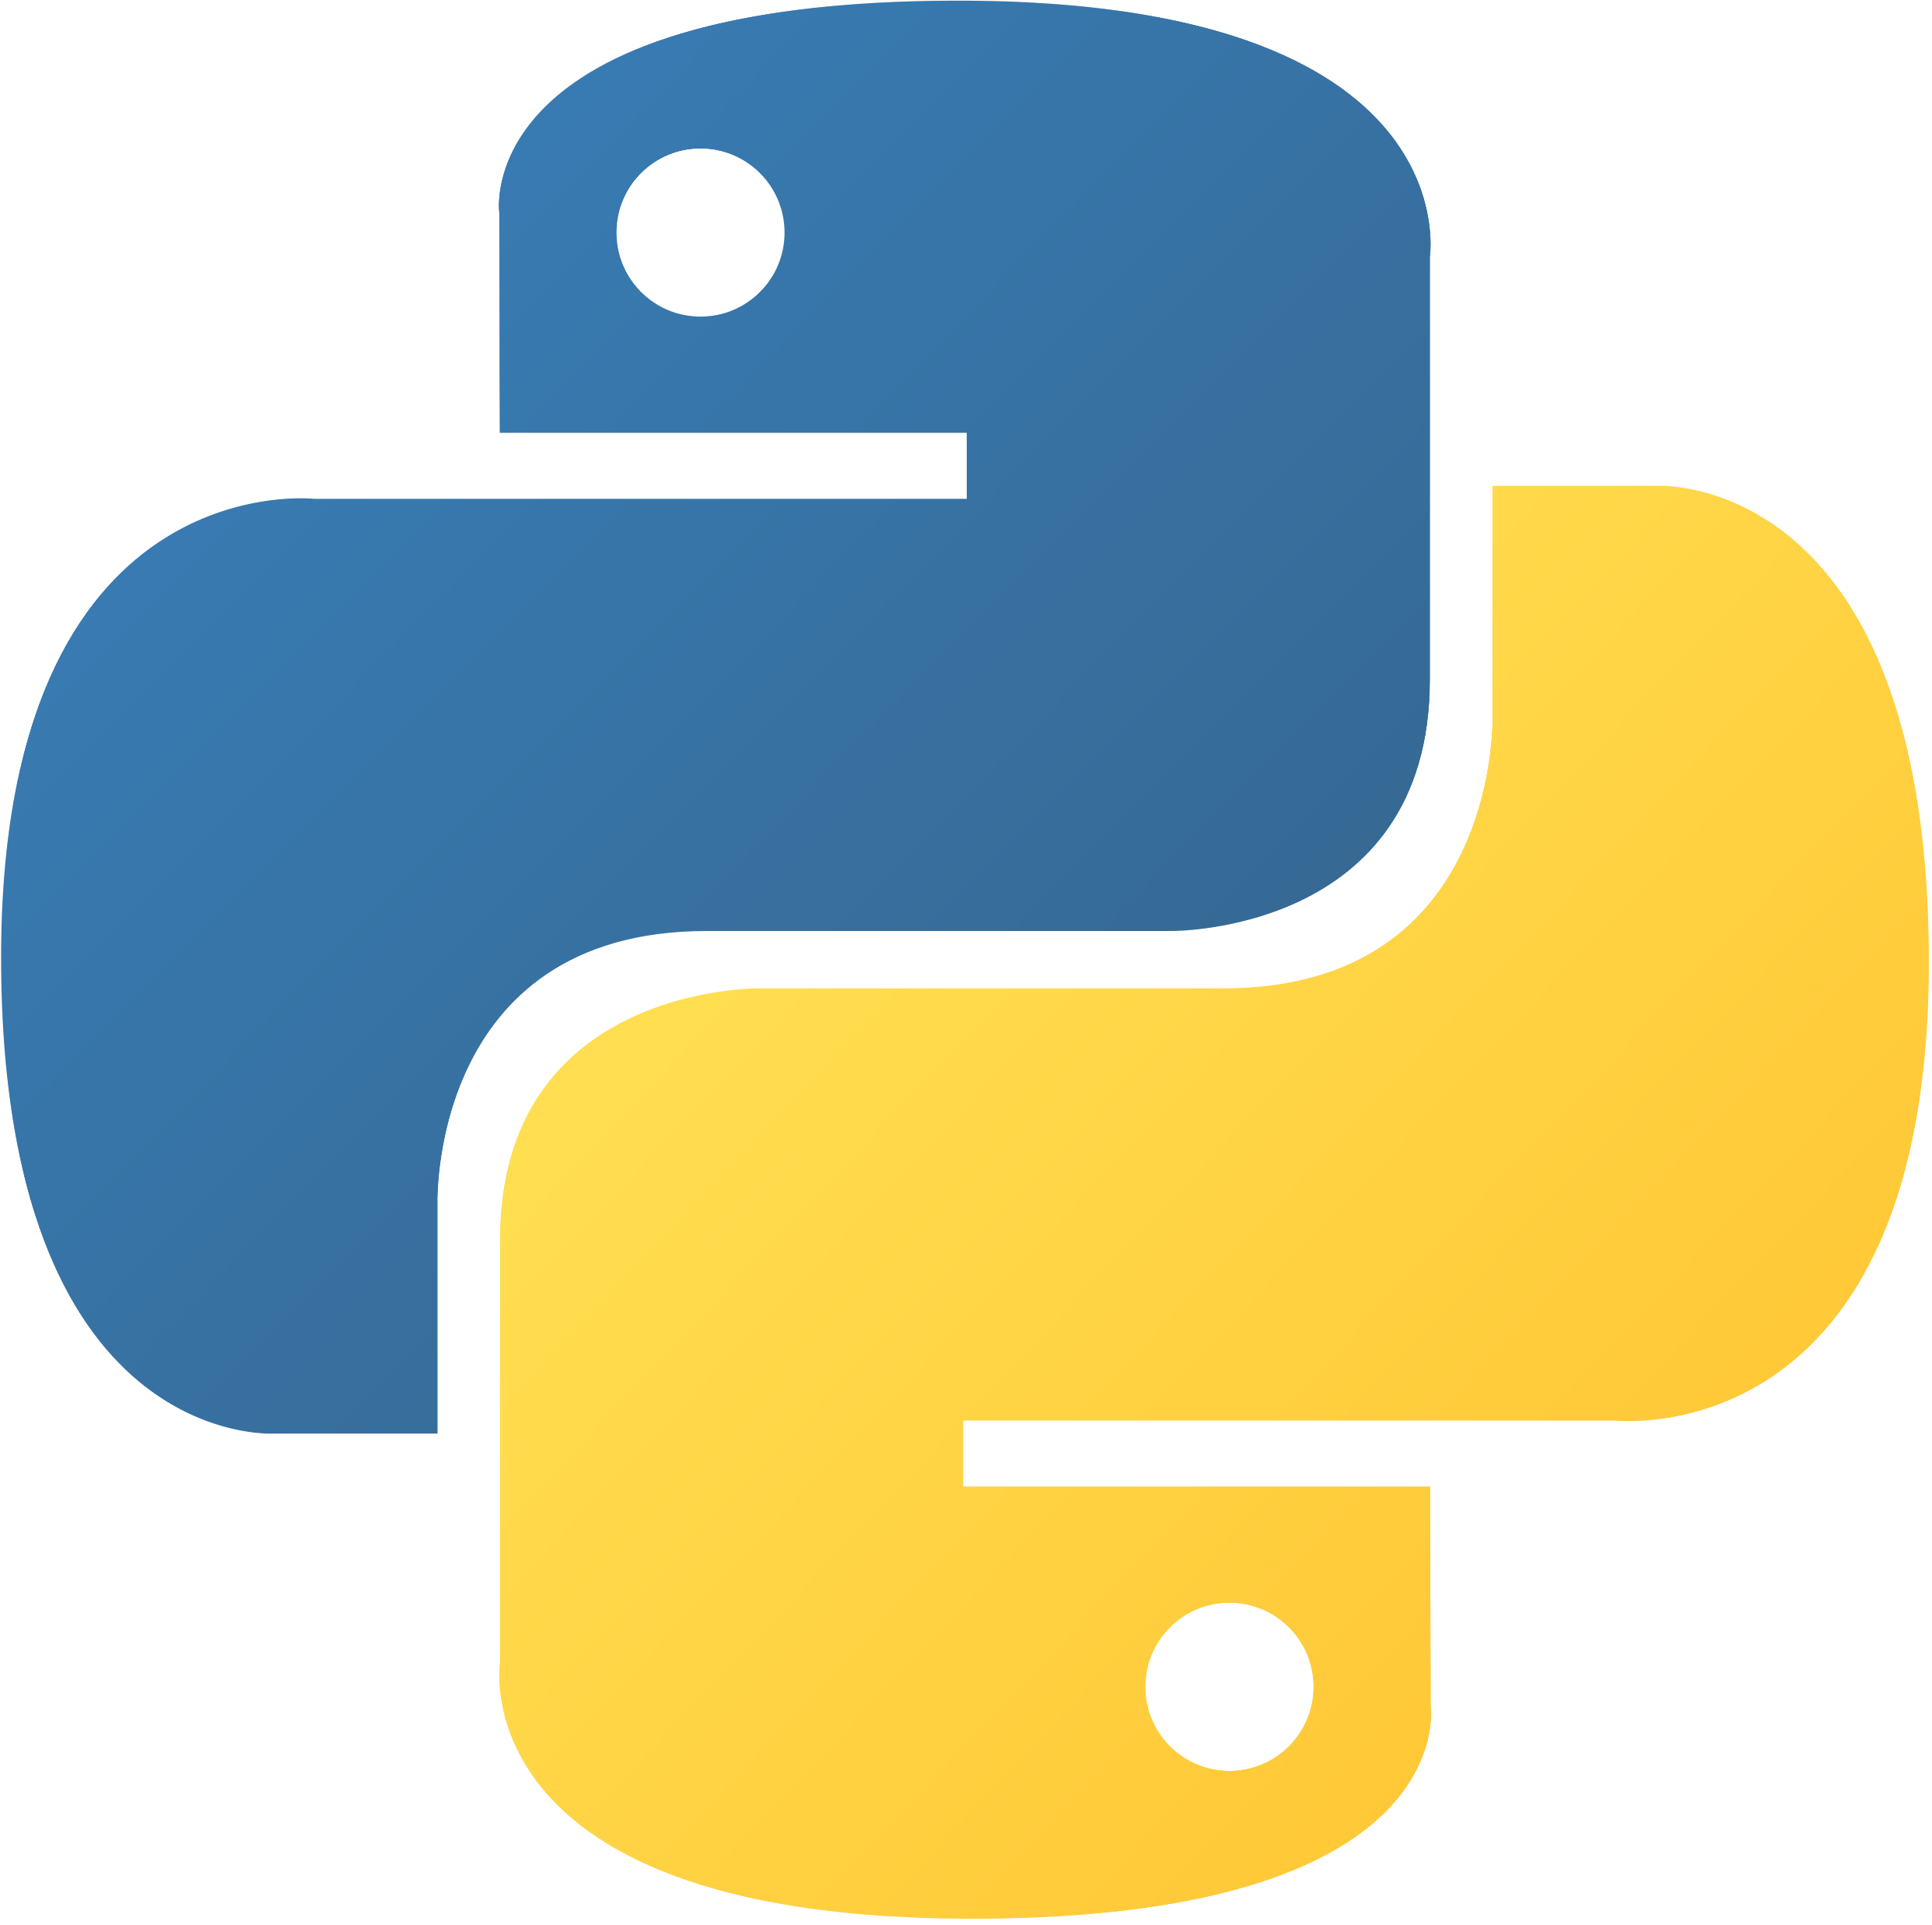

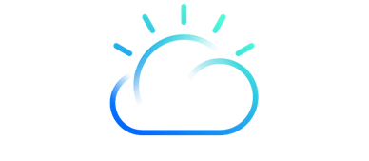
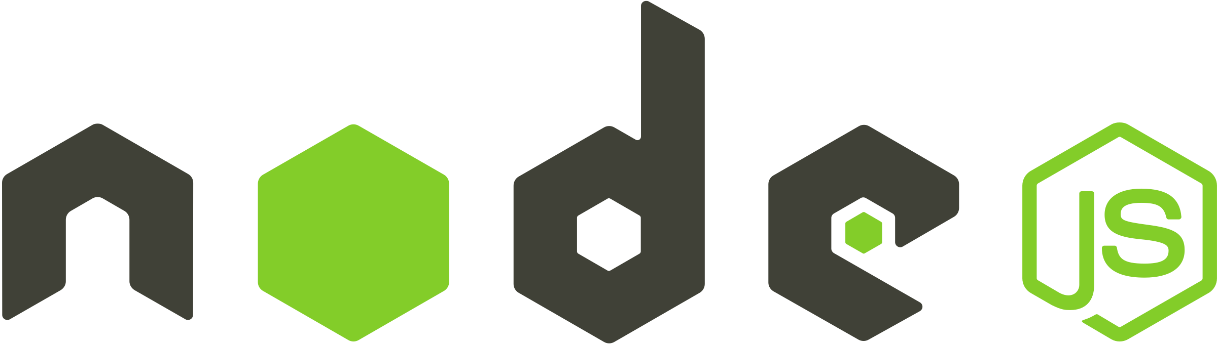
Technology stack
FRONTEND
API
Machine Learning
Database
CLOUD
ReactJS
NodeJS
Python
PostgreSQL
IBM cloud
React (also known as React.js or ReactJS) is a free and open-source front-end JavaScript library for building user interfaces or UI components.
Node.js is an open-source, cross-platform, back-end JavaScript runtime environment that runs on the V8 engine and executes JavaScript code outside a web browser.
Python is an interpreted high-level general-purpose programming language. Its design philosophy emphasizes code readability with its use of significant indentation.
PostgreSQL is a free and open-source relational database management system (RDBMS) emphasizing extensibility and SQL compliance.
IBM cloud computing is a set of cloud computing services for business offered by the information technology company IBM.

Slide 6
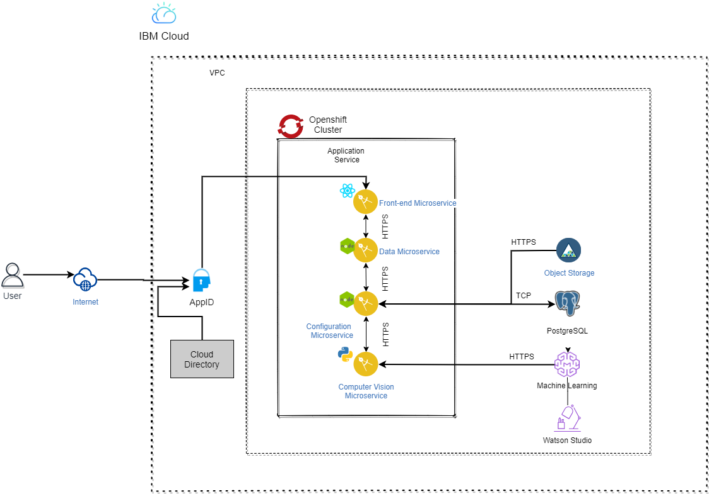
Architecture

Slide 7
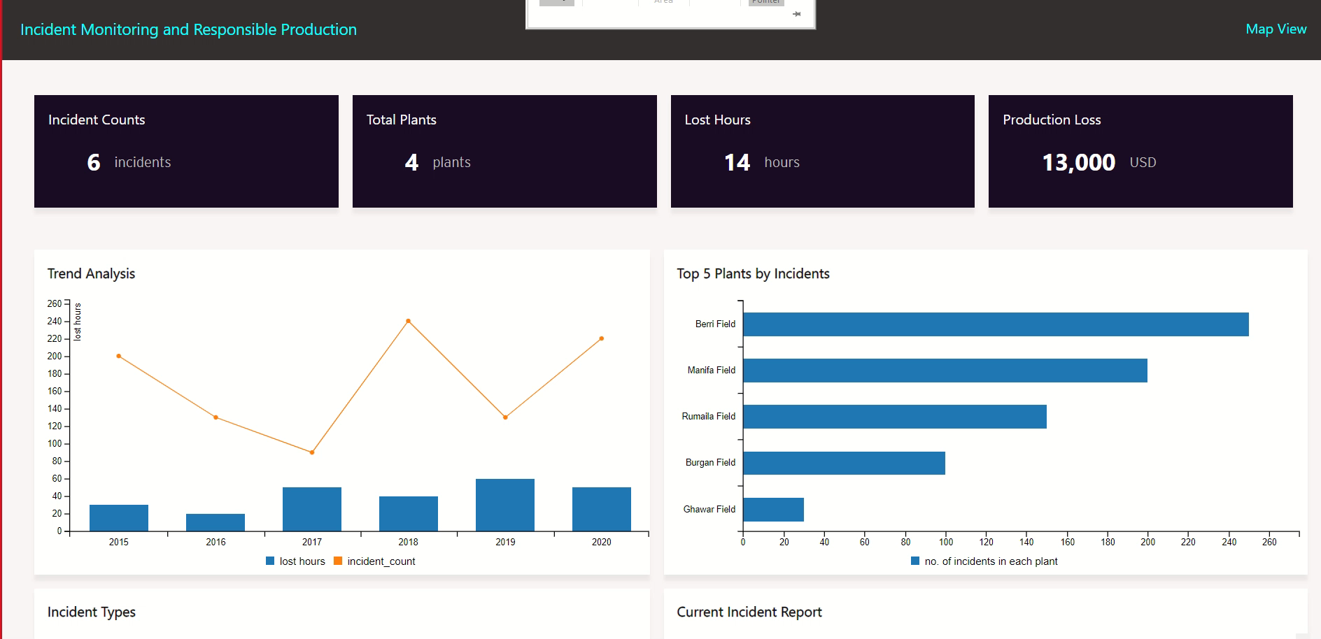
Demo Video

Slide 8
Future Roadmap
Using thermal images from drone cameras to identify oil spills, temperature breach etc.
Integration with ERP Solutions to enable automatic creation of work order requests in the backend, that will enable the rescue operations team to take immediate actions.
Integration with IoT platforms to leverage data received from physical devices and sensors such as temperature breach, fire out bursts within a boiler unit and many more.

Slide 9
Team Information
Souvik Majumder
Srisivasakthi Ramalingam
Ramya M M
Nivedha T
Sai Deepthi Singa Reddy
EY GDS Consulting
EY GDS Consulting
EY GDS Consulting
EY GDS Consulting
EY GDS Consulting

